Slide 1
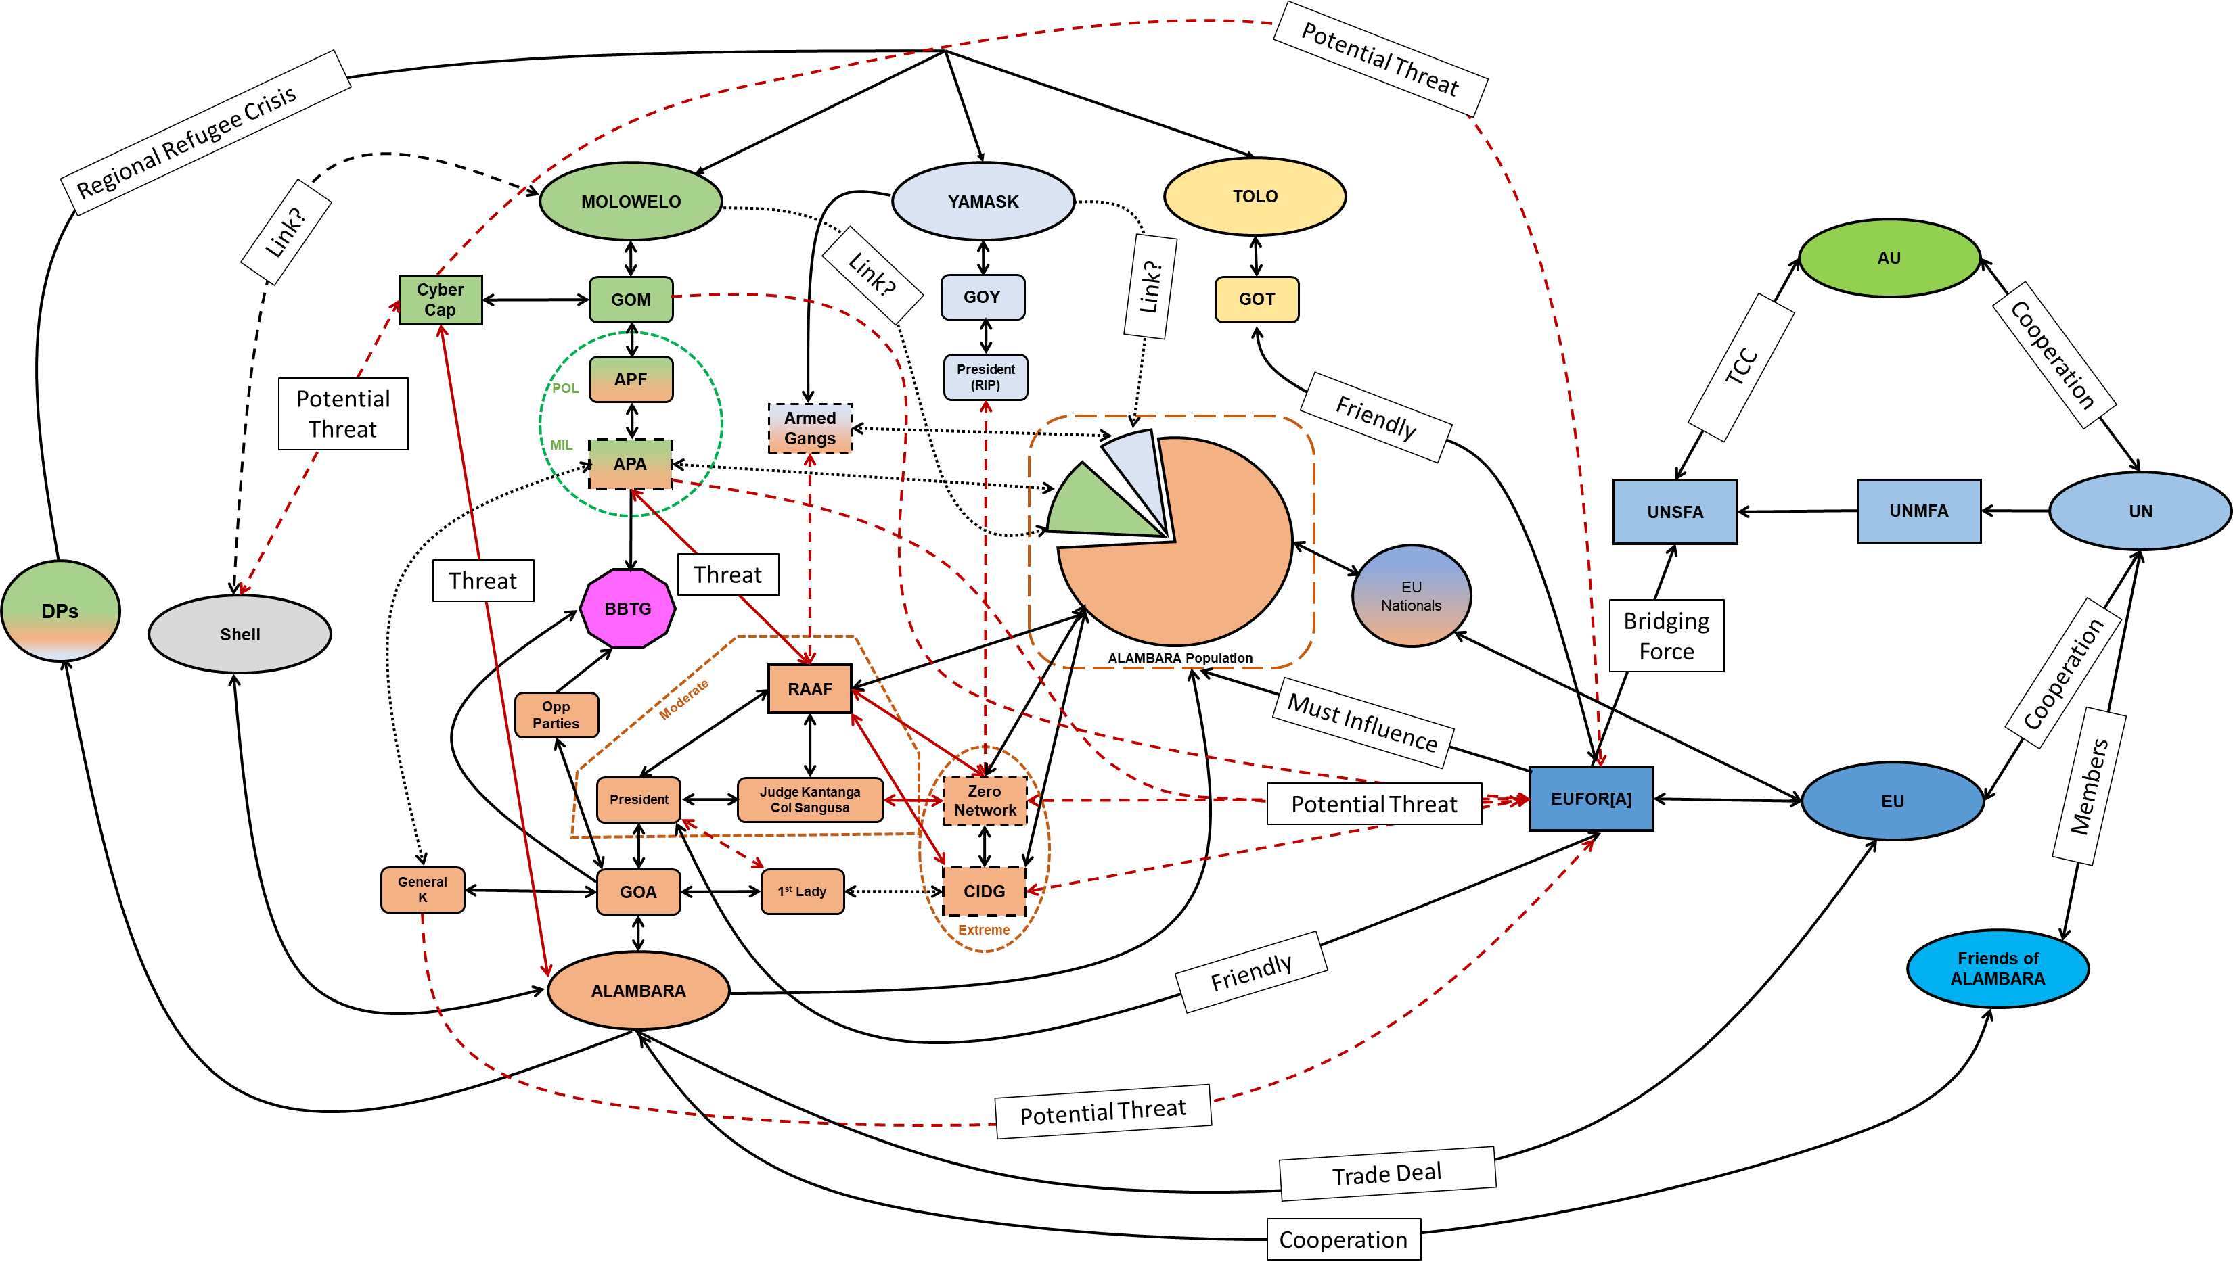

Slide 2
Maintain Relationship
Maintain Relationship
President
GOT
Maintain Relationship
Moderate 1st Lady’s position
1st Lady
GOY
Strengthen friendly actors
Reduce hostility
General K
Judge Kantanga
Col Sangusa
GOM
Reduce General’s Position
GOA
APA
APF
Influence Opp Parties towards friendly
Opp Parties
Increase capability
CIDG
Zero Network
Degrade capability
RAAF
Degrade capability
Influence
Degrade capability
Armed Gangs
Friendly
Neutral
Hostile

Slide 3
Reassure
Quelo
Maintain
1st Lady
Persuade
Manori
CIDG
Discredit
Persuade & Reassure
GOA
President
Int Comm
RAAF
Uvembi
GOM
W YAM
Discredit
IDPs
APA
APF
GOT
CHINA
Influence
Armed Gangs
Zero Network
S MOL
Friendly
Neutral
Hostile

